Slide 1
Rides Project
Eugene Cheah
Mengting Yang
Rahil Shah
Notes:
Good Afternoon One and All,
Me and my teammates Mengting Yang and Eugene Cheah are working on the Ride Hailing Project

Slide 2
a. Abstract (10 %)
b. Introduction (5 %)
c. Code with Documentation (50%)
d. Results (20 %)
e. Discussion (10 %)
f. References (5 %)

Slide 3
Problem Statement
For Driver:
Not enough rides to support expenses like insurance and the car
Really low profit margin for the amount of time invested
Notes:
Being an Uber driver may sound lucrative, but how real is it and can the time utilization be maximized as they also need to pay for expenses for running the car or its insurance. An Uber driver may happen to be driving at a particular location, but there is no guarantee that there are passengers there, if any. Logically speaking, it is better to have accurate predictions for an Uber driver to decide upon his/her own schedule, maximize earnings in a shorter time, and on top of that knowing all the best driving locations where ride-hailing customers are densest

Slide 4
Abstract
An analysis to optimize Uber and Lyft drivers’ rides in Boston.
For Driver:
Improvizing rides to decide upon his/her own schedule
Maximize earnings in a shorter time
Know all the best driving locations where ride-hailing customers are densest
For Customers:
Have an idea about when rides’ prices are the cheapest
Compare the price between Uber and Lyft
Notes:
Our analysis will allow to optimize the rides for Uber and Lyft drivers.
The main improvements for the driver would be
Firstly, the drivers would be only working when they think its most profitable for them making them decide their schedule.
Secondly, they can maximize their earnings by look at the factors affecting the price estimates.
Thirdly to allow the driver to find the hotspots around them so they can improve their probability of getting a ride.
The improvement for the customers is that they can get an idea when the rides prices are the cheapest, also they can compare the prices between Uber and Lyft.

Slide 5
Data Source: Uber API, Lyft API, Yelp API, Weather API
Factors: Time, Day, Location, Weather, Temperature, Special Events
Learning methods: Time Series, Support Vector Machines, K- Nearest Neighbors, and Naïve Bayes
Notes:
Since we cannot get the actual rides data from Uber or Lyft, due to privacy purposes. So for creating a dataset that would be close to a real life simulation we chose factors like weather, time, location,temperature, etc. We have started our work using Time series analysis as it makes indexing and categorizing easier for our dataset. We are looking forward to use other algorithms like Support Vectors, K - Nearest Neighbors, and Naive Bayes, for further analysis.

Slide 6
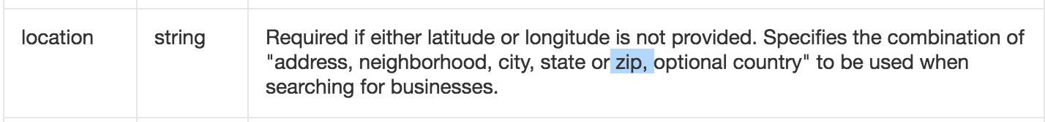
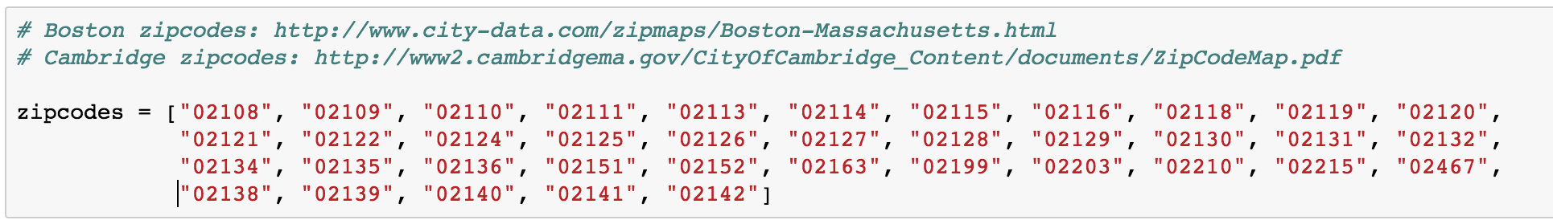
Code with Documentation
1.Select Locations: Boston and Cambridge areas
2.Get Zipcode in Boston and Cambridge areas
Notes:
To predict accurately and to restrict the scope of project, we are using the locations only within the city i.e. Boston and Cambridge Areas.
We are using zip codes to categorize different neighbourhoods within the city to make the search easier.

Slide 7
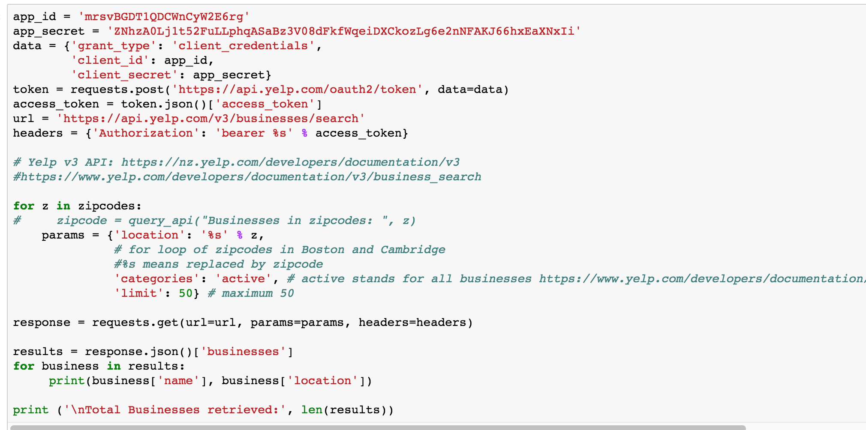
3. Get Locations and Coordinates according to Zip code
and Create Yelp database to store data
Notes:
We are not using random coordinates to get source and destination because they give problematic locations like parts of oceans,etc. Instead we are using the Yelp API to get proper location. We also get more information about the businesses set up at those locations.

Slide 8
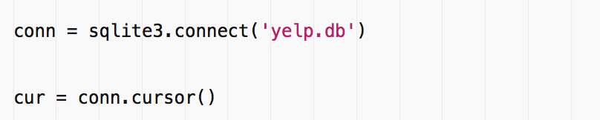
4. Connect to Yelp Database in Script
* SQLite is a relational database management system and it is not a client–server database engine. Rather, it is embedded into the end program.
* It allows accessing the database using a nonstandard variant of the SQL query language

Slide 9
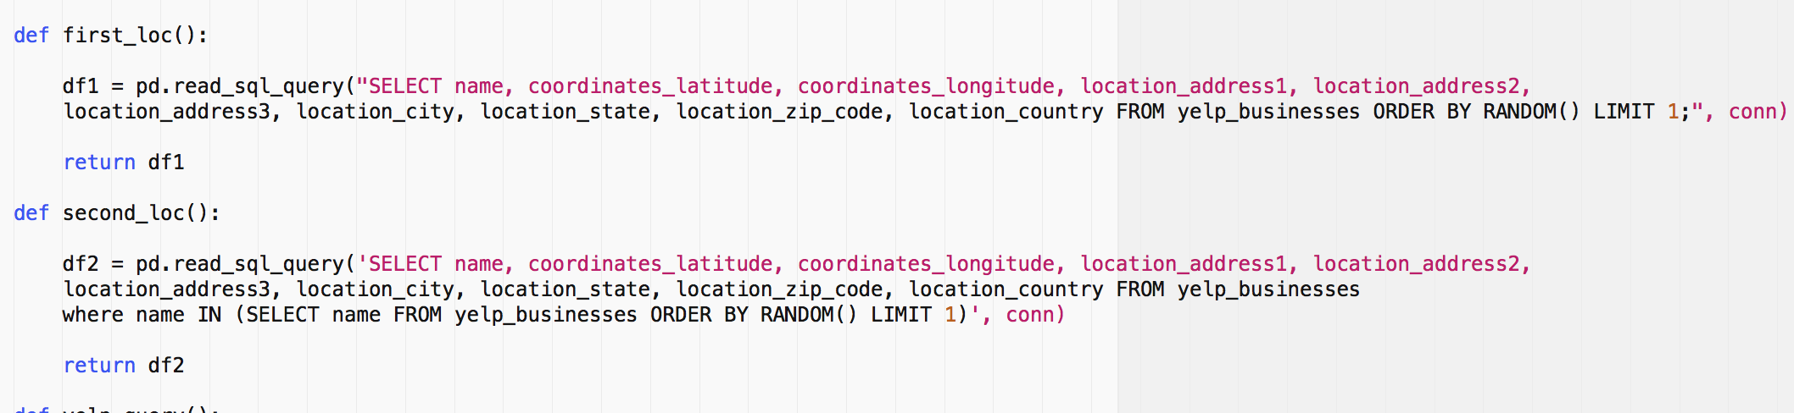
5. Get the Start Location and End Location of each query
* The distance between start and end location should larger than one mile
Notes:
The above two commands allow us to query the Yelp Database to get name, coordinates, address, city, state, zip code, country.
This will allow us to get random source and destinations. We are considering one factor that the distance between the source and the destination should be more than 1 mile.

Slide 10
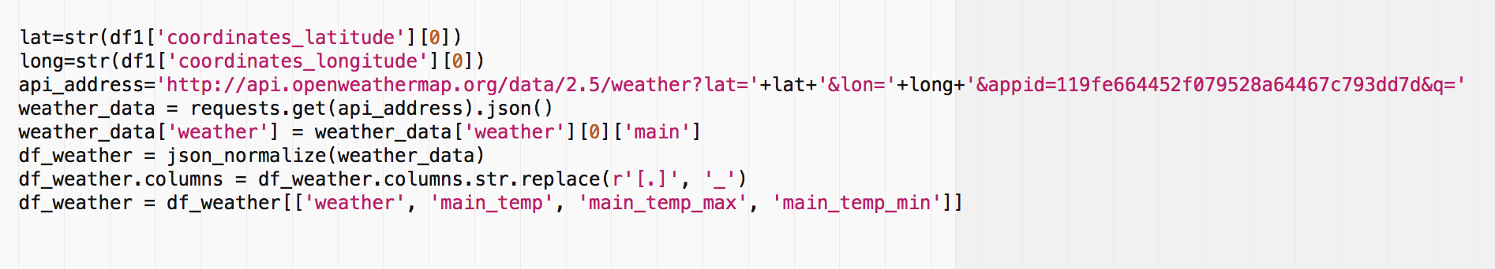
6. Get the Weather and Temperature
Notes:
We use the openweathermap api to get the weather and temperature for the source coordinates.

Slide 11
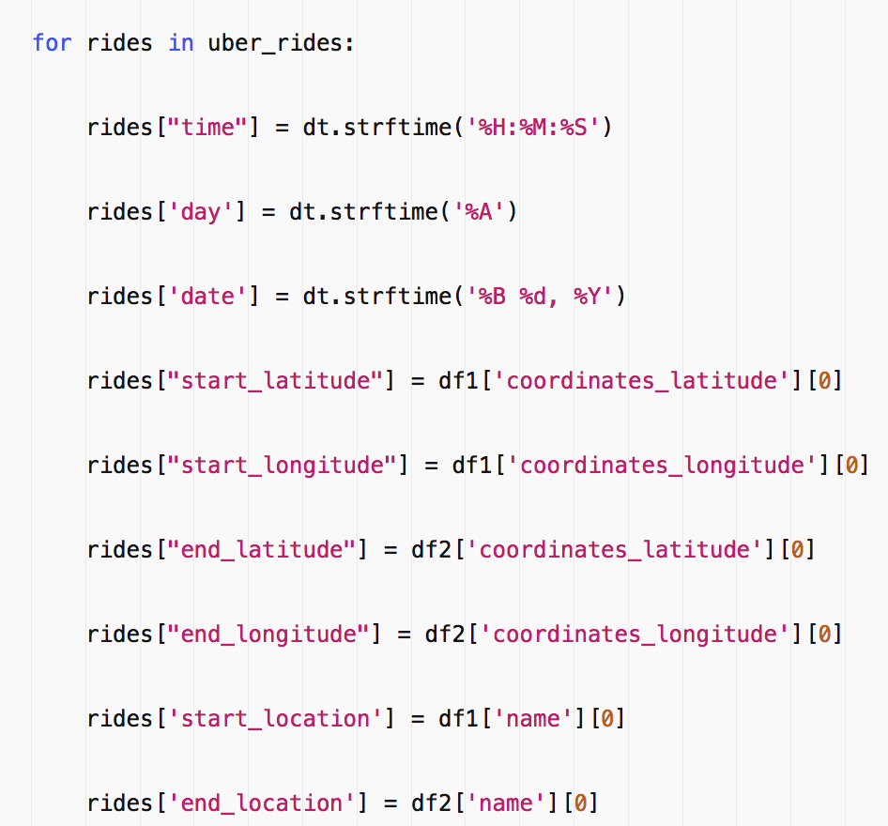
7. Get data of Uber rides
Notes:
This allows us to append date-time and location information to the uber database we are creating. So when we make an api request for getting the prices for the desired source and destination, we append this data to it and save it to a csv file.

Slide 12
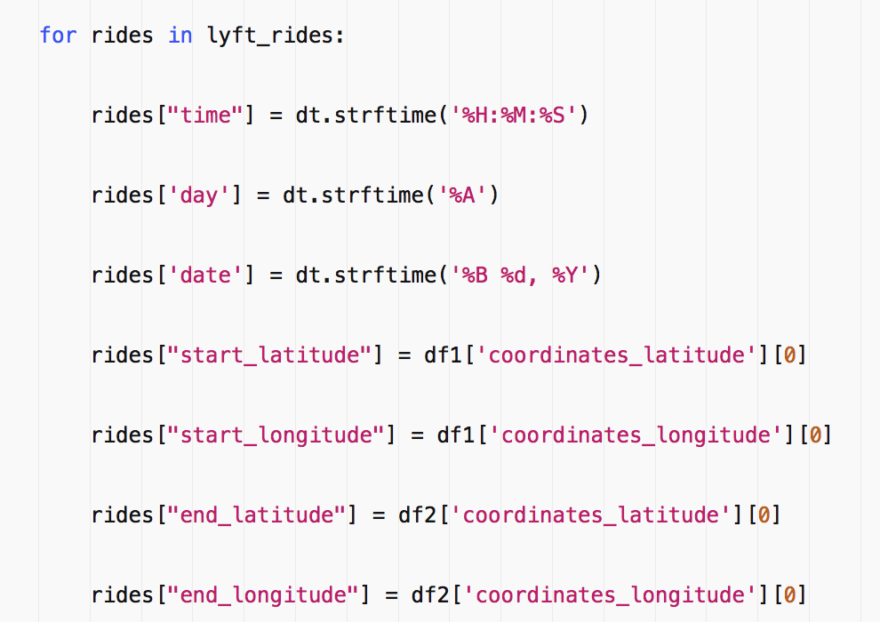
8. Get data of Lyft rides

Slide 13
9. Put it on server to run for one week
We choose Amazon Web Services (AWS) and set up an Ubuntu server to perform a Cron Job. It executes our Python script every three minute via crontab, which continuously appends data to and increases the dataset for the project.
* Ubuntu is an open source software operating system that runs from the desktop, to the cloud, to all your internet connected things
Notes:
So we have created a script that crawls through all the api to create a database. But it's not a one time thing, we need to continuously collect data so we can perform any analysis on it. So we chose to deploy the script on an AWS Ubuntu server. This runs our python script every 3 minutes via cronjob.

Slide 14
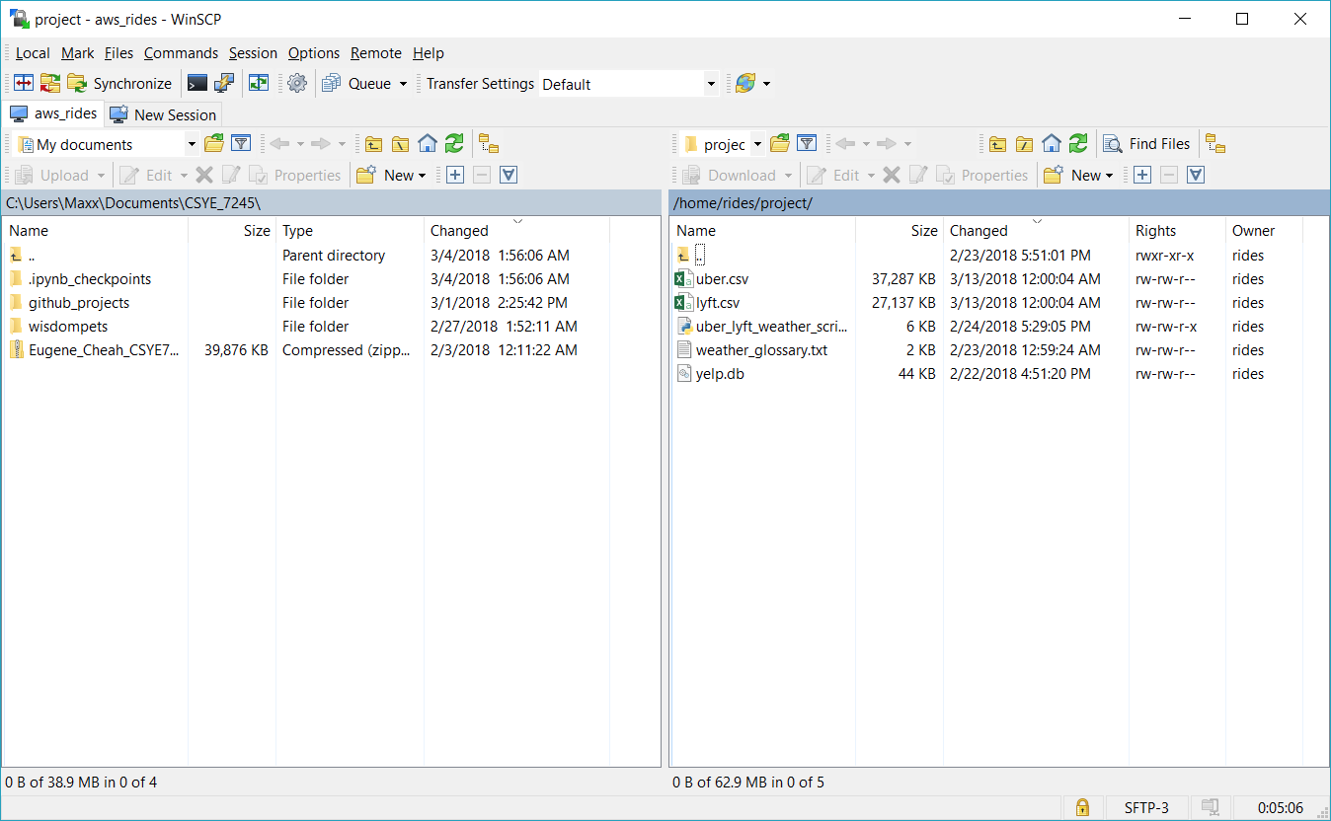
screenshot of the server

Slide 15
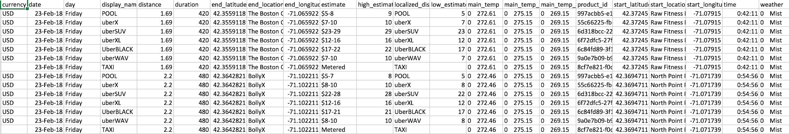
Uber.csv
Notes:
This a screenshot of our Uber data that we have scraped throughout the week.

Slide 16
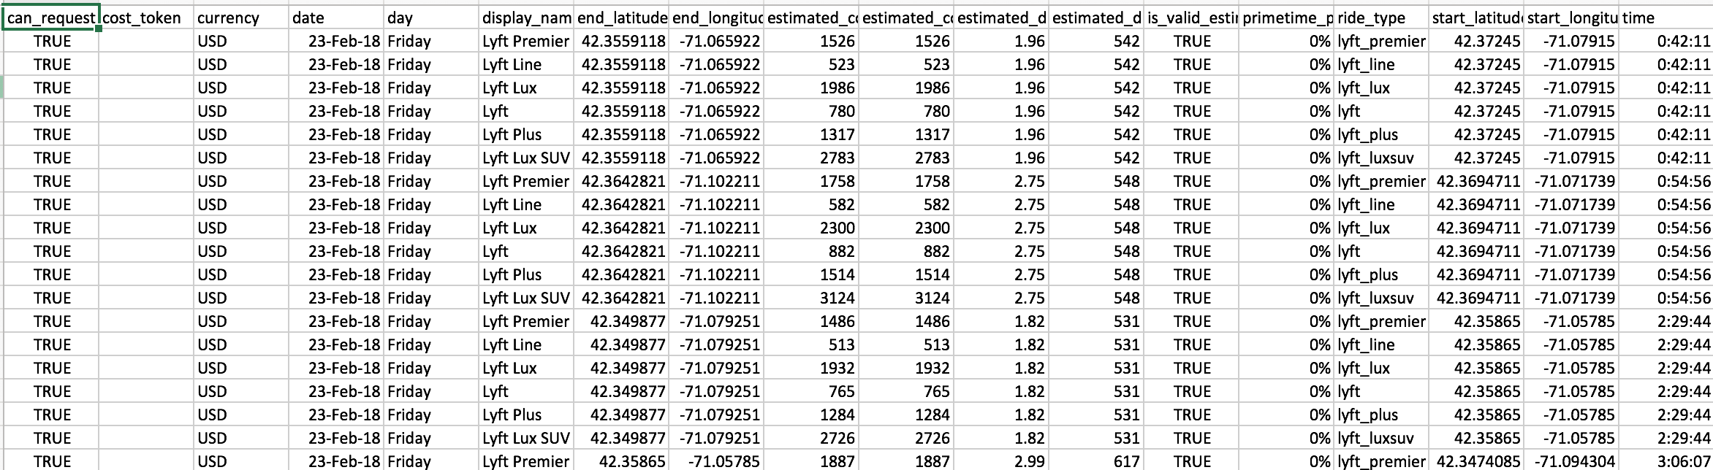
Lyft.csv

Slide 17
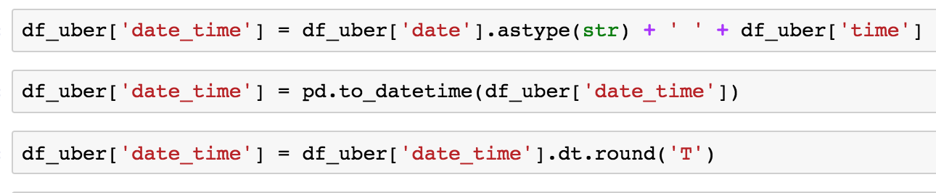
10. Read Uber csv
Combine day and time and round into minute
Notes:
Once we have our data we need to remove the useless column that do not provide any useful. Also we are manupalating our date_time column for ease of access.

Slide 18
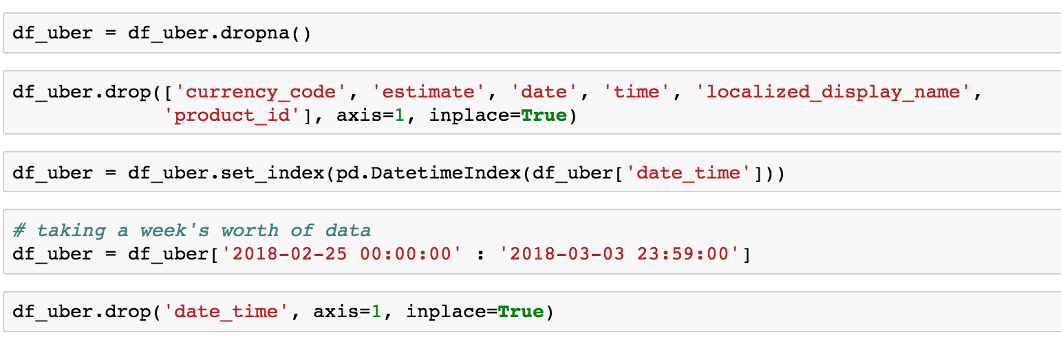
11. Drop null and unnecessary columns
set time as index
select the time period
Notes:
Then we set the date_time as our index to allow us to perform some time series analysis.

Slide 19
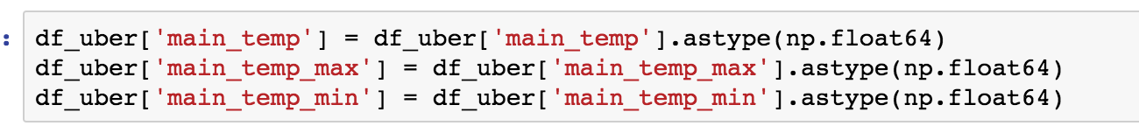
12. Transform inappropriate data types
Notes:
We implement some data transformation for getting appropriate outputs in our plots.

Slide 20
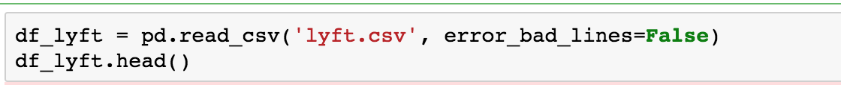
13. Read lyft csv (most same as Uber)
* error_bad_lines: Lines with too many fields (e.g. a csv line with too many commas) will by default cause an exception to be raised, and no DataFrame will be returned. If False, then these “bad lines” will dropped from the DataFrame that is returned.

Slide 21
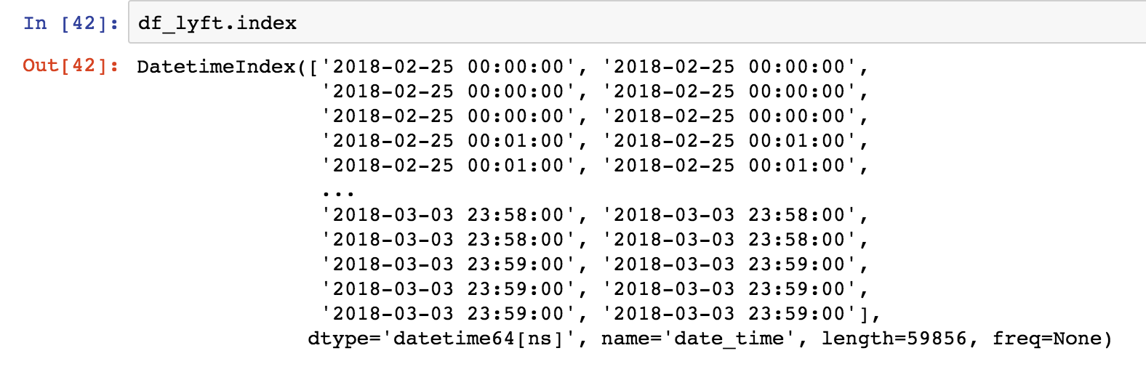
14. Check Index
Notes:
Maybe delete this slide

Slide 22
15. Drop unecessary columns
* date, day, time are same as Uber
Notes:
Maybe delete this slide as well

Slide 23
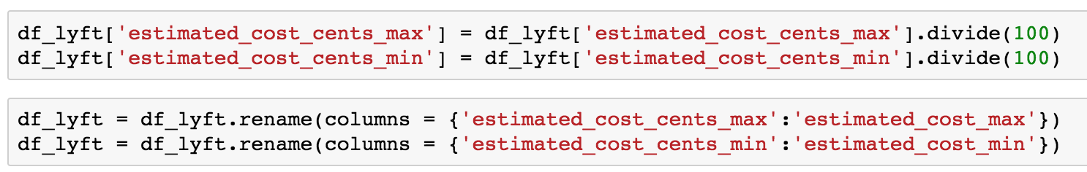
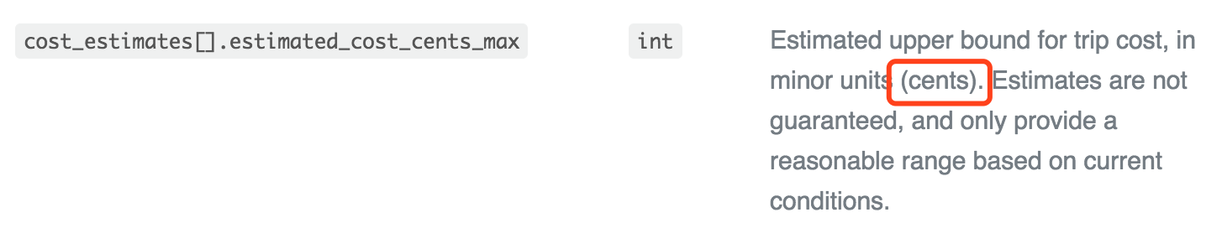
16. Make sure the cost expressed in same way between Uber and Lyft
* Lyft uses cents while Uber uses dollars
Notes:
We are now trying to merge both the lyft and uber in the near future, so we want both of the database have same currency units. Making it easier to compare.

Slide 24
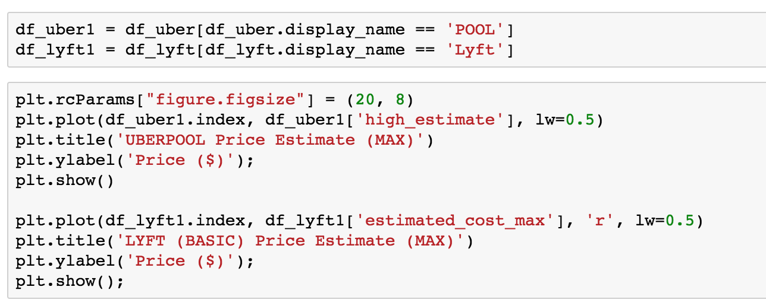
Result

Slide 25
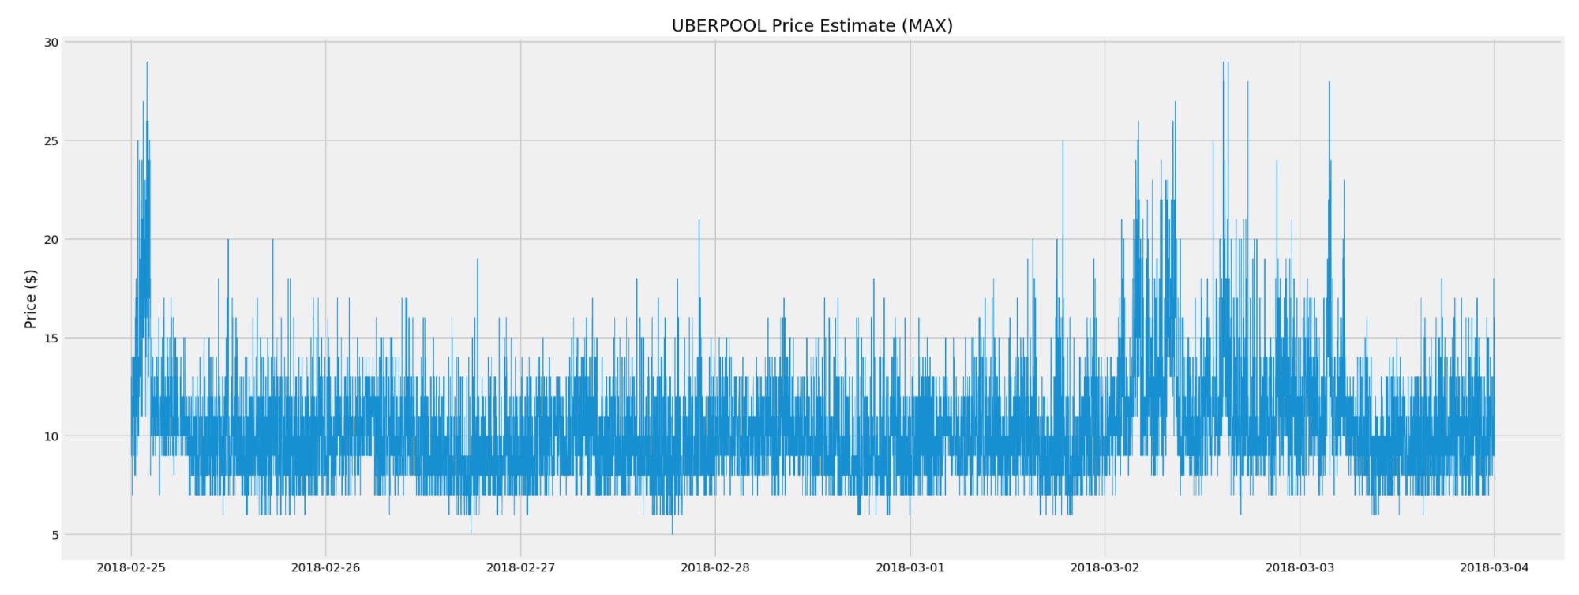
Feb 25th is Sunday and March 2nd has Rain and Snow
This proves Day and Weather affects price much
Notes:
We can see from the plot that the uber prices fluctuate a lot and there is a drastic increase in prices on some days. When we included some factors like weather, we can understand that when the weather is rough uber tends to spike its prices. Also on weekends when people tend to go out more often, it increases it prices.

Slide 26
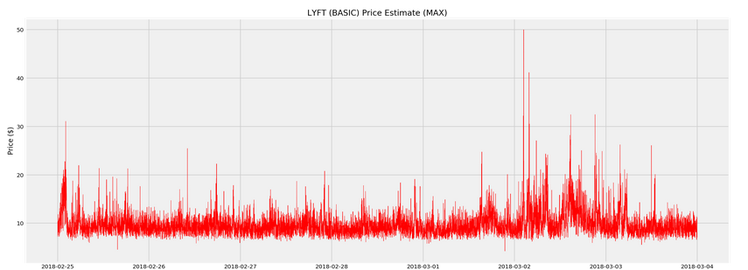
Since Y-axis of Lyft is much larger than Uber
It is cheaper to use Uber for customers when weather is terrible
On the contrast, it is better for driver to choose Lyft
Notes:
We can see from the plot that the Lyft prices are more stable than Uber. There are high fluctuations when the weather is bad.

Slide 27
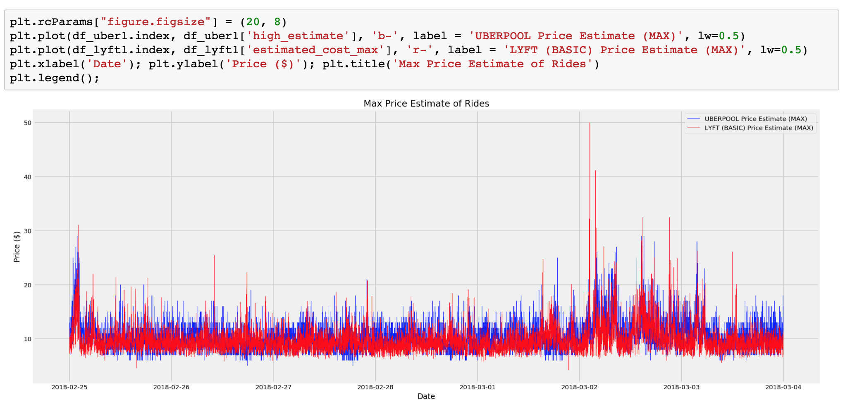
Normally, Lyft is cheaper than Uber
but when it faces high demand, its price is much higher than Uber

Slide 28
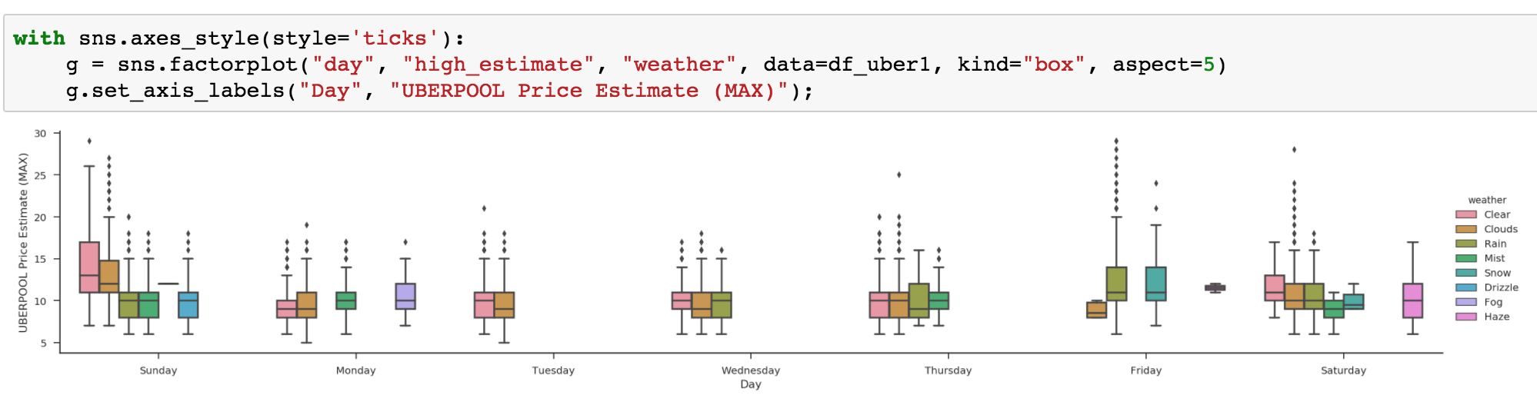
When there’s a bad weather, outliers becomes more
Price range become larger

Slide 29
What we do next
Merging Uber and Lyft data frame
Data visualization
More analysis
Get conclusion

Slide 30
References
[1] Uber Api
https://developer.uber.com/dashboard/
[2] Lyft Api
https://www.lyft.com/developers
[3] Weather Api
https://openweathermap.org/api
[4] Yelp Api
https://www.yelp.com/developers
]

Slide 31
Discussions

